Slide 1



‘Poker Online’ Project review
Team Members:
Amit Zohar
Ofek Ben-Atar
Ophir Nahshoni
Golan Parsha

Slide 2

Managers Review:
“Poker Online” is a web-based online multiplayer game, full stack developed by our team. The project is based on a Signal-R server which controls and manages the game play. It contains a JavaScript written Web Page for the best user-experience, and saves all the data in a Database which enables a Disaster Recovery of a client and\or a server.

Slide 3
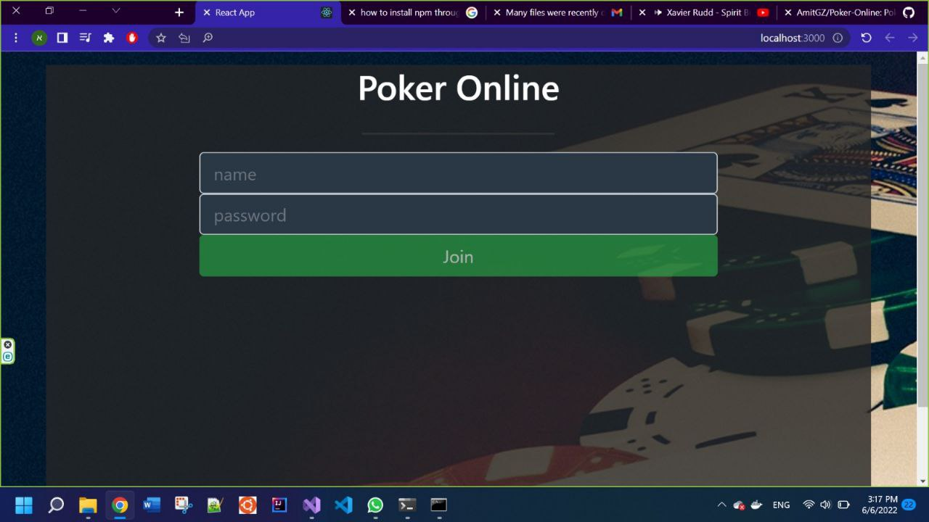
Game Play Screenshots:
Sign-In screen:

Slide 4
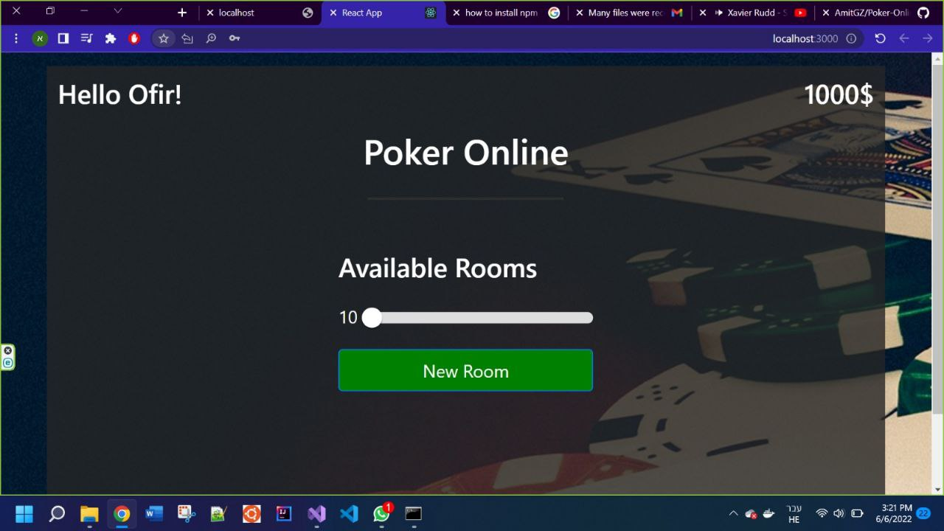
Game Play Screenshots:
Lobby, after Ophir has signed in:

Slide 5
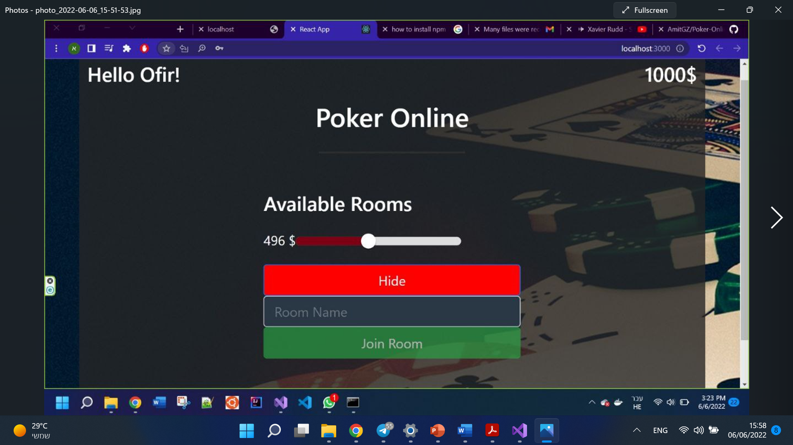
Game Play Screenshots:
Providing the starting amount of money:

Slide 6
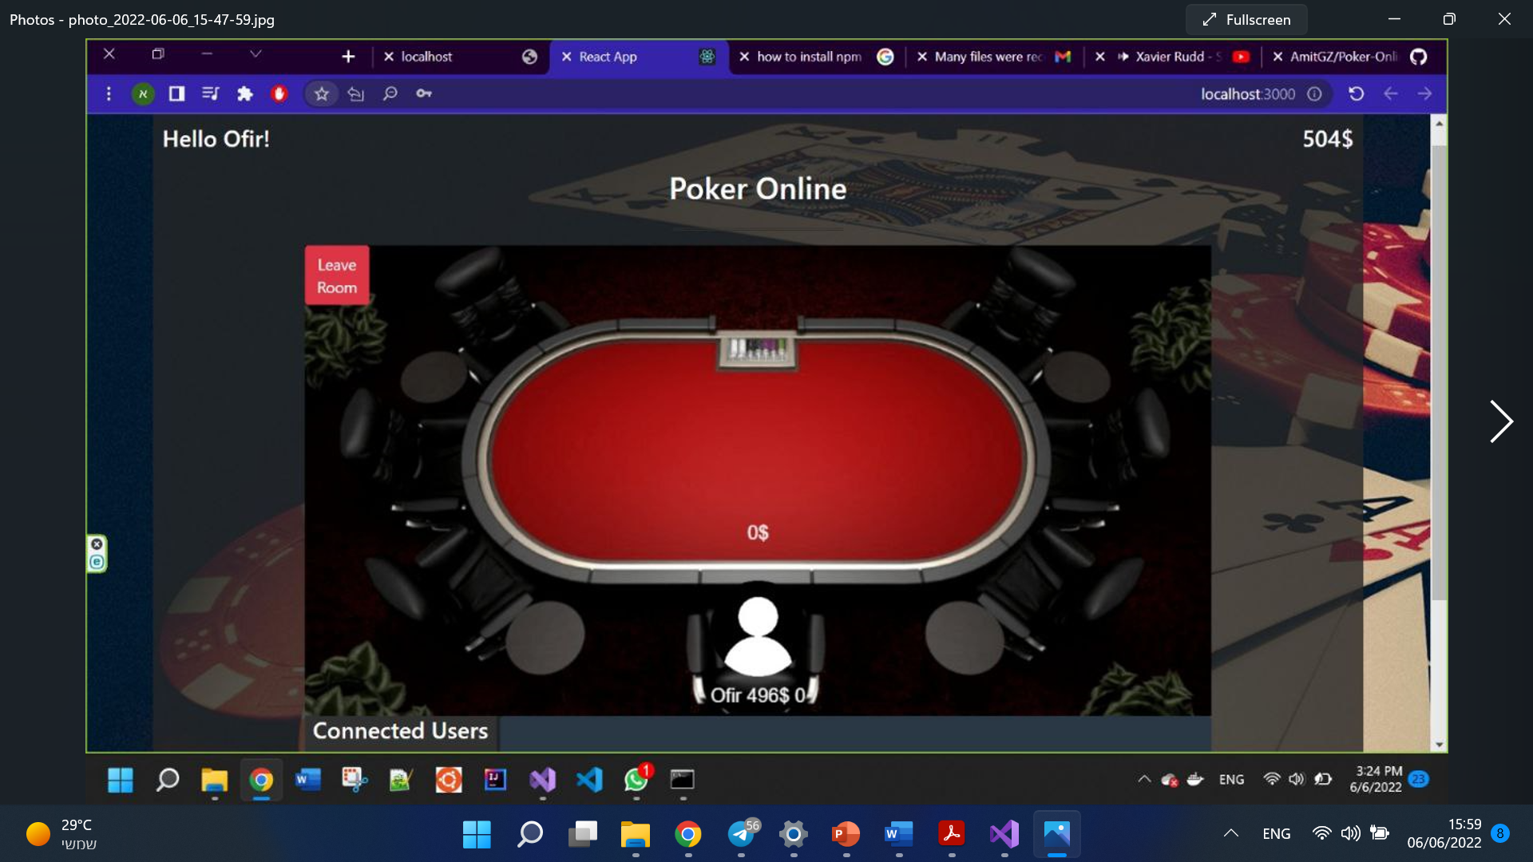
Game Play Screenshots:
The created room, with just Ophir inside:
Ophir now has 1000-496 =504$ remained
Ophir entered with 496$

Slide 7
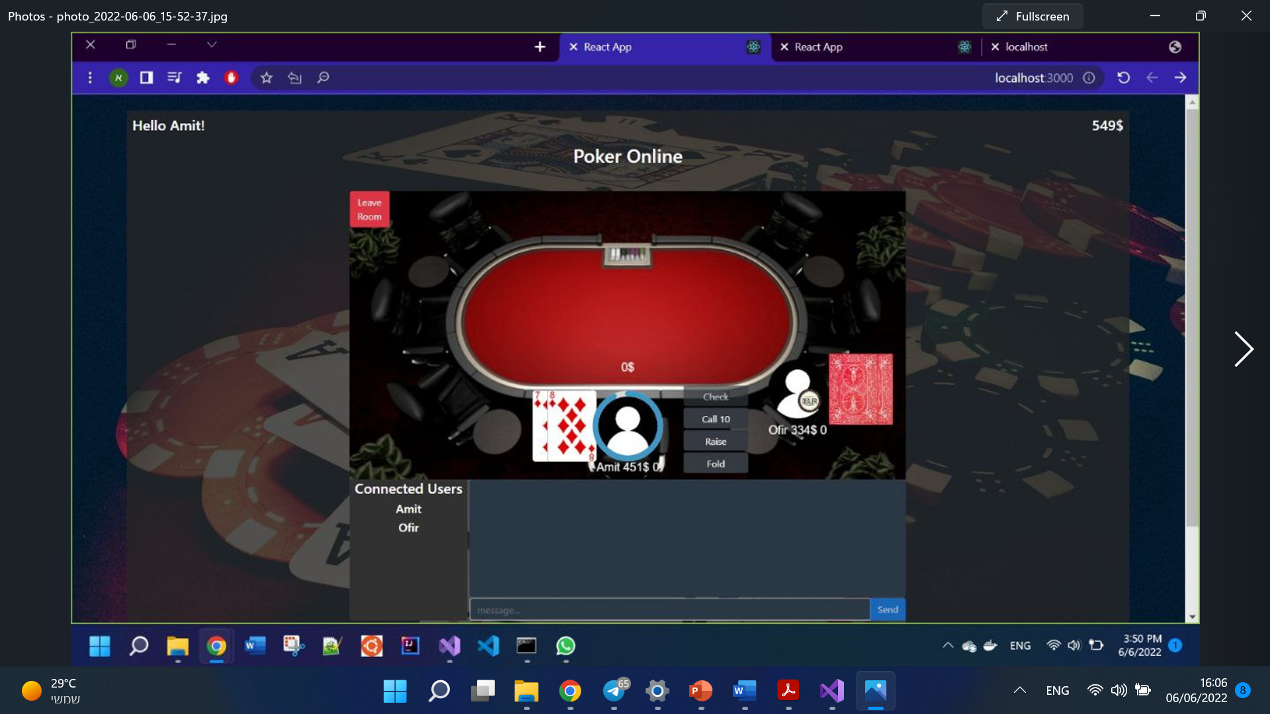
Game Play Screenshots:
Amit’s screen after he joined the room. Notice that he’s centered, and can only see his cards:
The players are able to chat

Slide 8
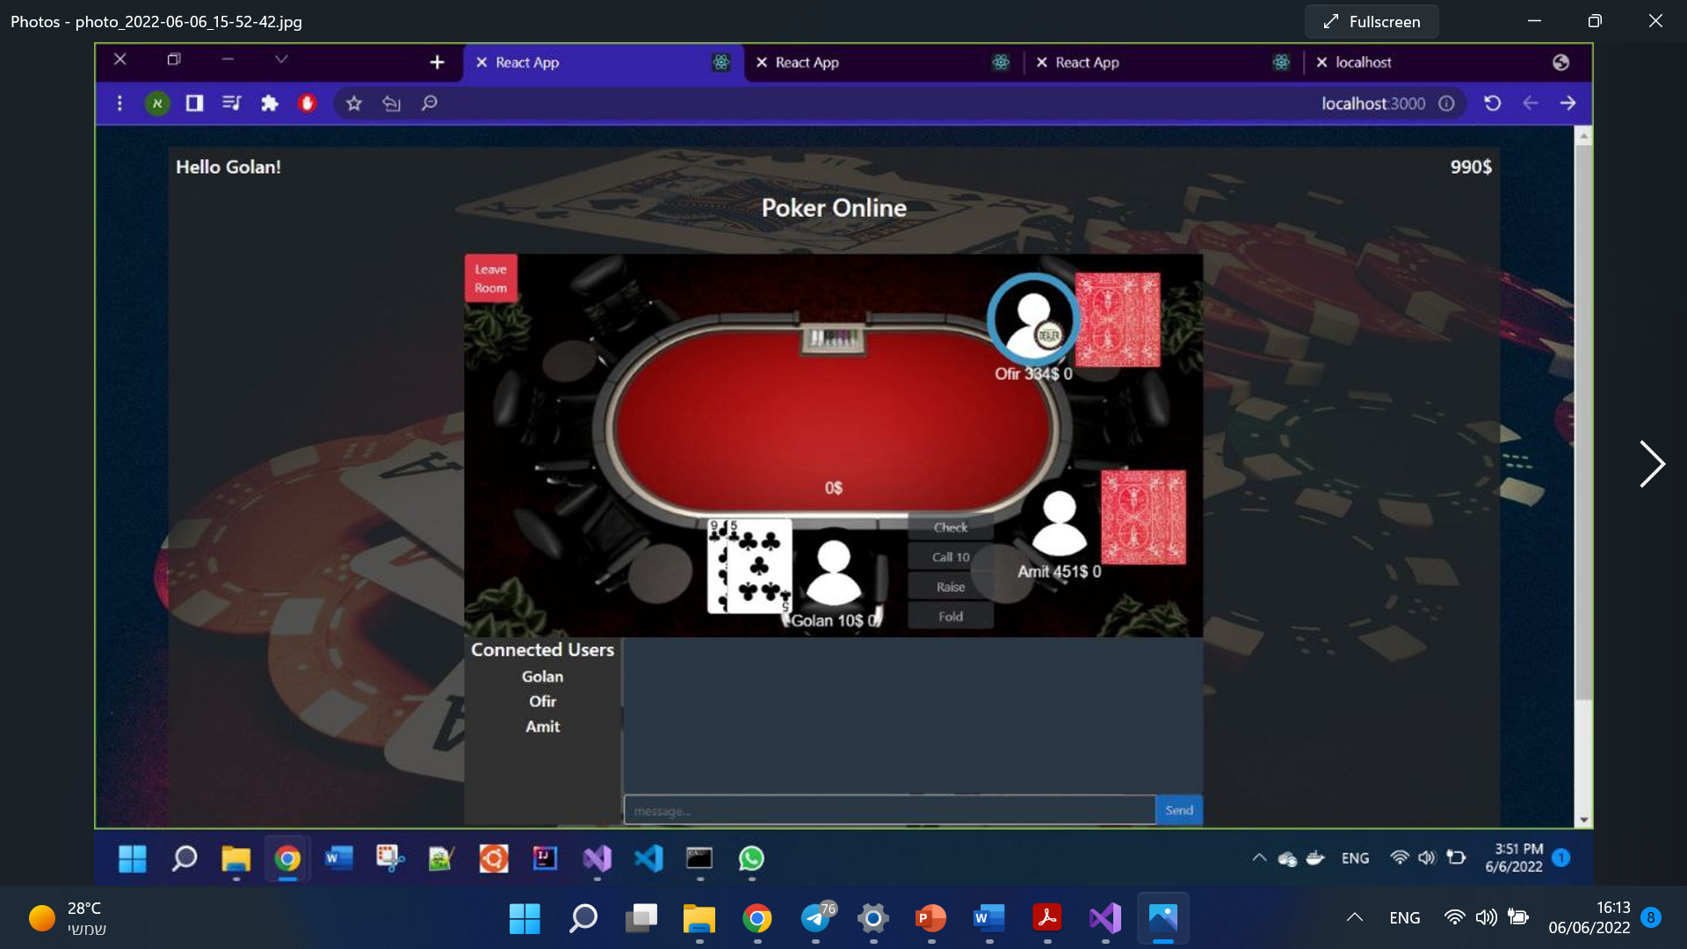
Game Play Screenshots:
Golan’s screen when he joins. Notice again that he’s centered, and can see only his cards :

Slide 9
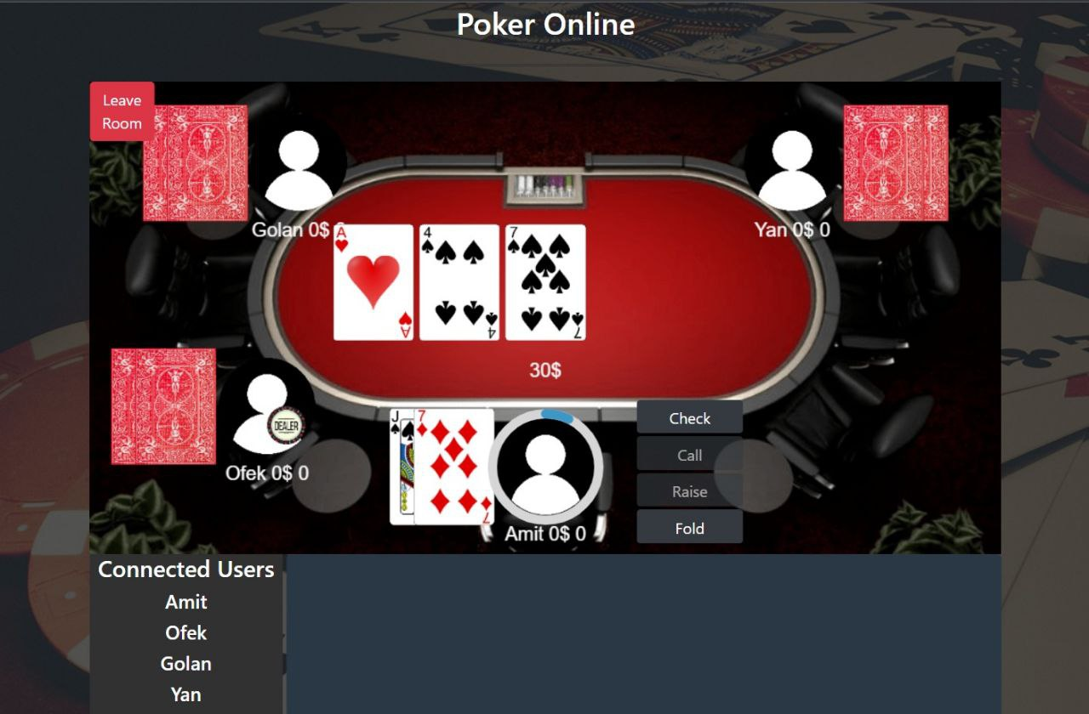
Game Play Screenshots:
All participants can see the flop (the cards on the deck):

Slide 10
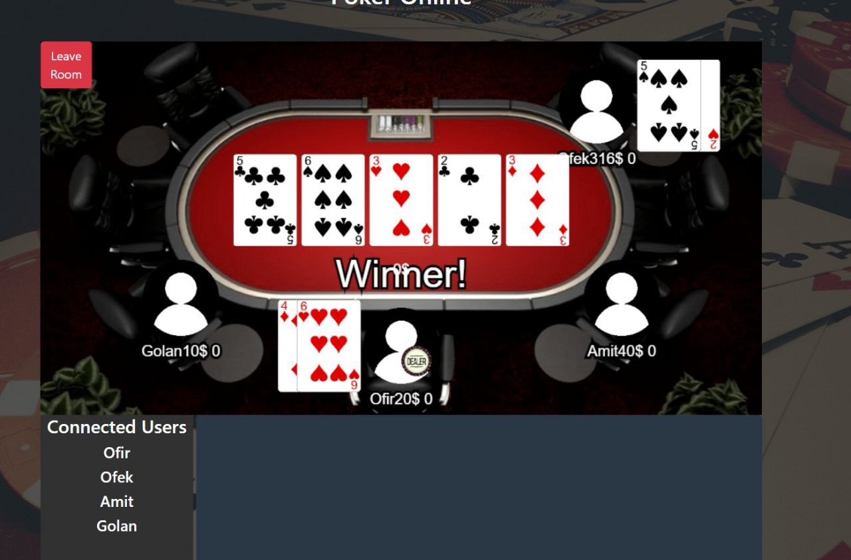
Game Play Screenshots:
At the game end we can see in this game the winner (Ophir’s pair 6 are stronger than ofek’s pair 5).

Slide 11
Use-Case Table:
Comments | Explanation | Player Name
 | Each user who got in the welcome page, and yet to be identified by the system. The Visitor can Register, or Log-In if he already had an account. | Visitor
 | After being identified by the system, the user is moved to the Lobby, where he can open a room (a game) or join an existing one. | User
 | When entering a room, becomes an active player, and can participate and play in game when a new roud starts. | User in-game

Slide 12
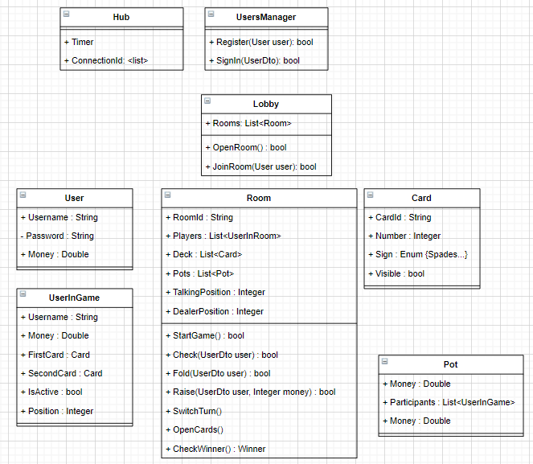
Class Diagram:

Slide 13

Use-Case Diagram:
Register
Log-in
Visitor
Create Room
Join Room
Player in Lobby
Check
Fold
Player in Game
Raise

Slide 14


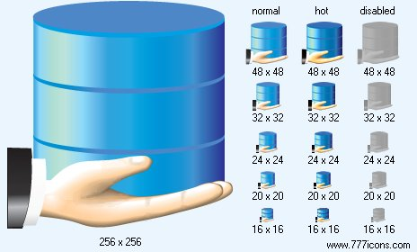

Physical Architecture:
Client
Server-Hub
DataBase
Client
Client
Client

Slide 15




Logical Architecture:
Presentation Tier
Application Tier
Data Tier
Signal-R Server
Client-1
Data
Con-Id-1
Timer
Home Page
Functionality
Users-Table
User-Id-1
Register
Rooms-Table
Sign-in
Client-2
Cards-Table
Lobby
Room
Con-Id-2
Visitor
Create Room
Check
Client-n
Con-Id-n
Join Room
Fold
User-Id-2
Raise

Slide 16
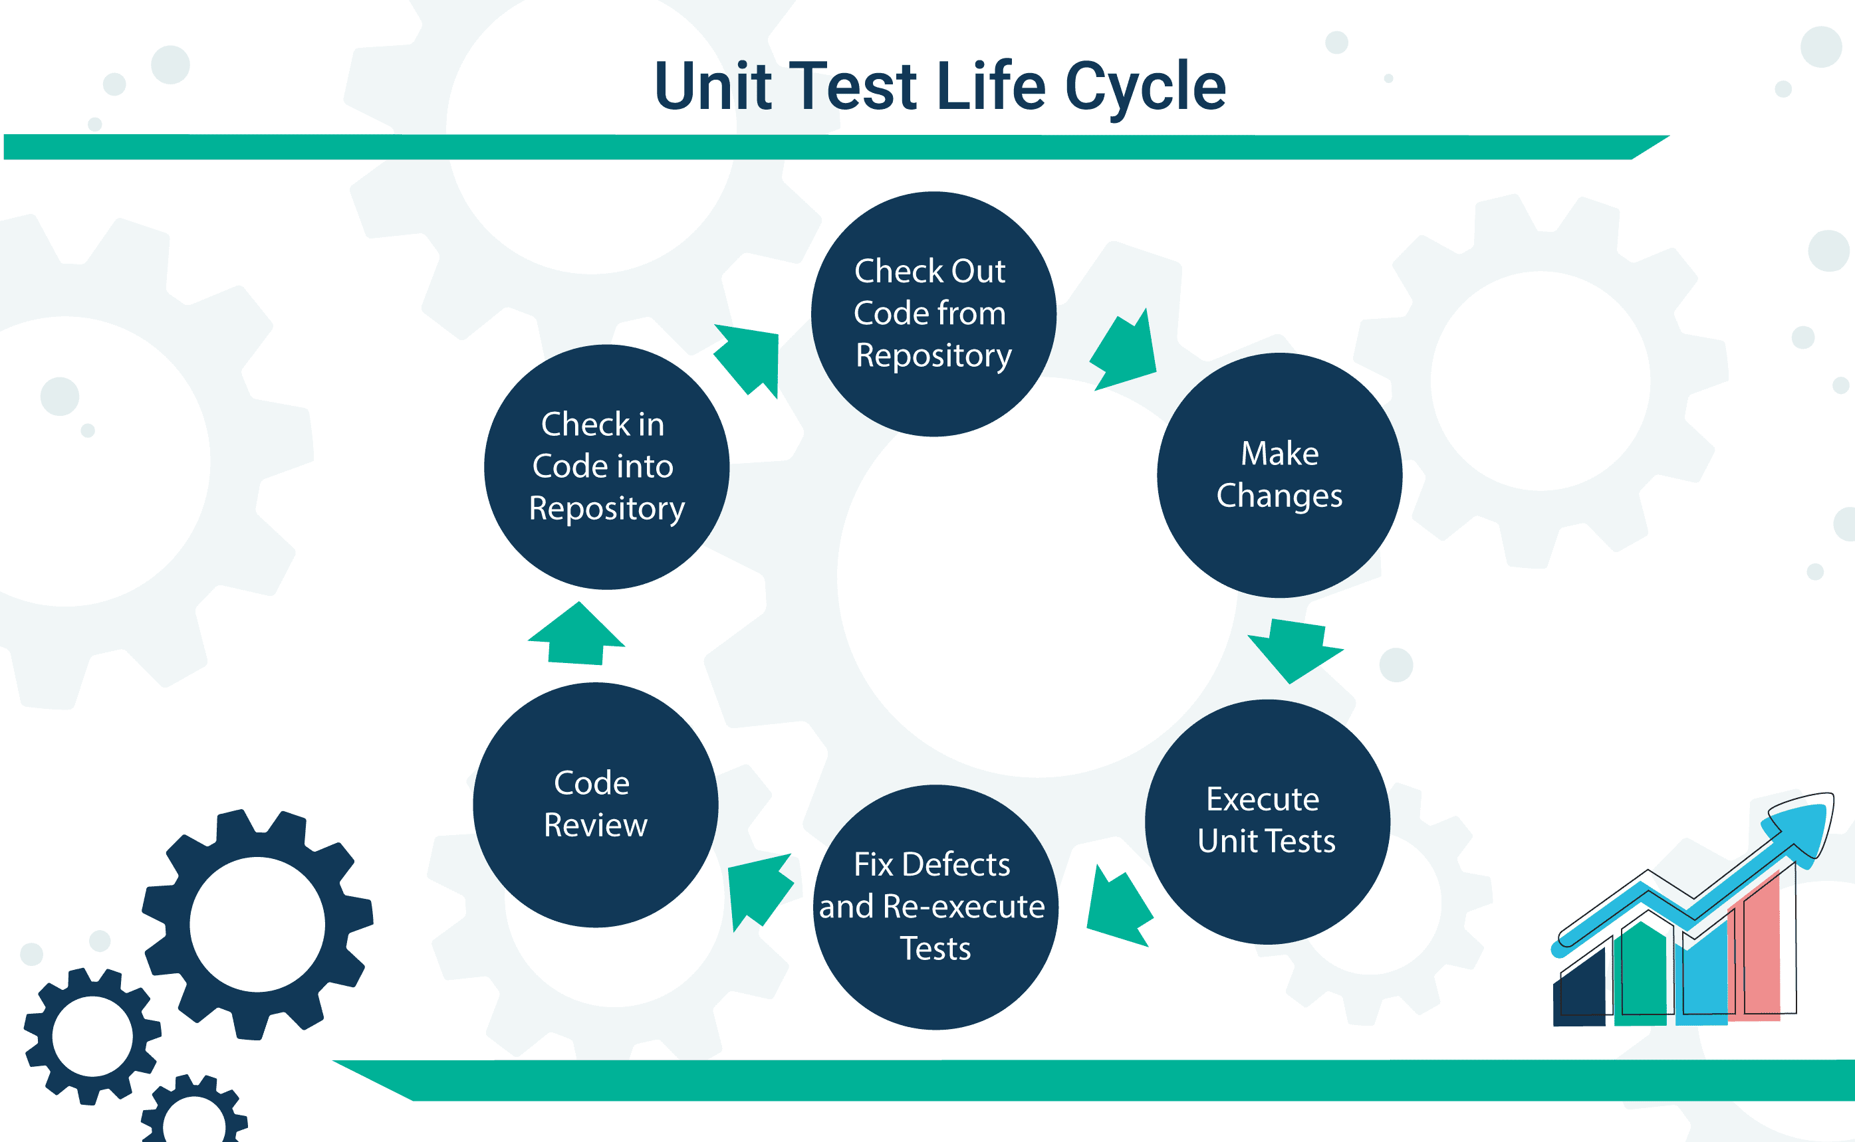

Tests:
Using xUnit package , C#
Separate projects for the tests - UnitTestsProject
Each test class deals with different class in DataModel folder
Classes that implement logic functions
No tests for classes and functions that have external
S.Number | Number of tests | Test class | DataModel class | Main Function
1 | 1 | UnitTestsCardHandler.cs | CardHandler.cs | GenerateShuffleDeck()
2 | 5 | UnitTestsUserInGame.cs | UserInGame.cs | ResetUser()
3 | 2 | UnitTestsRoom.cs | Room.cs | AddUser(User,Money)
4 | 3 |  |  | RemoveUser(User)
5 | 1 |  |  | EndGame()
6 | 1 |  |  | StartGame()
7 | 1 |  |  | Raise(UserInGame,amount)
8 | 1 |  |  | Check()
9 | 3 |  |  | ResetGame()
Total Unit Tests: 18

Slide 17



Workflow:
At this project we have learned a great lesson of how to manage a software development as a team.
We had a meeting each Tuesday, where we decided on a two-week sprint. and in the “free one” we discussed, shared, and made decisions on how to continue the project implementation. The main tool we have used are GitHub and Azure DevOps, which provided us a good infrastructure to manage and coordinate our project workflow

Slide 18

Summary:
This is the first time we had to develop an end-to-end project of this technical and team members magnitude. We are proud to have this game working.
We have learned many lessons, like how to approach the planning of a project, and encountered many professional challenges, which improved our skills and knowledge at software engineering.
We would like to thank Mr. Tamir Dresher on guiding us through this project.

